Slide 1


IDB Support for
Brazilian Aviation
August 2012
Donald P. Schenk
ACA Associates, Inc.
dpschenk@aca-assoc.com
+1 646-248-3461

Slide 2

Support for Brazilian Aviation
Presentation Outline
Brazil & Biofuels
Sustainability and Operational Efficiency
Role of Collaboration
Aviation & Brazil

Slide 3
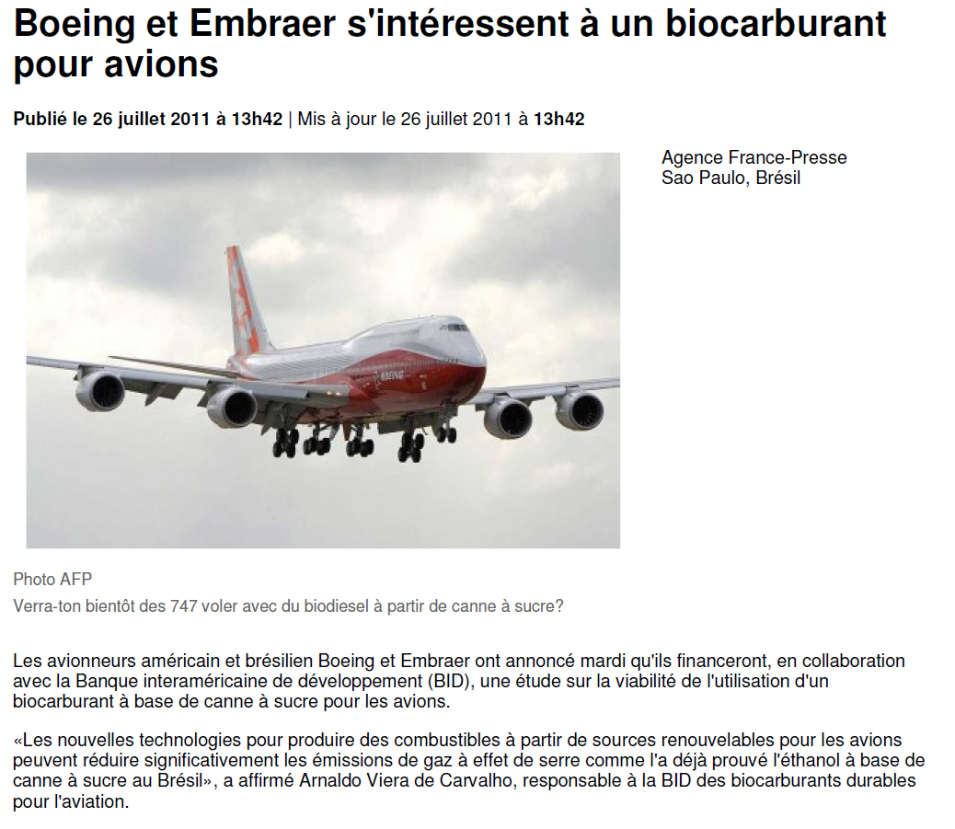
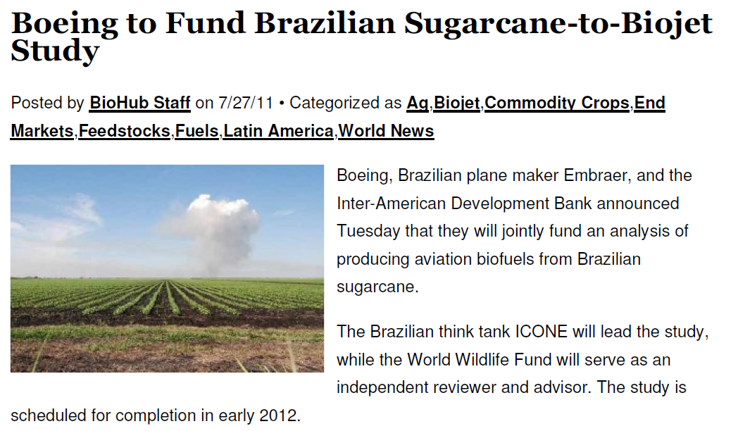
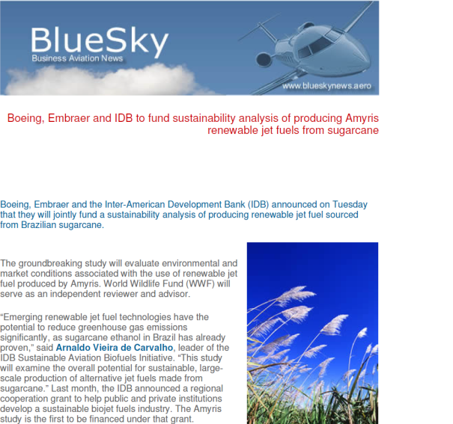
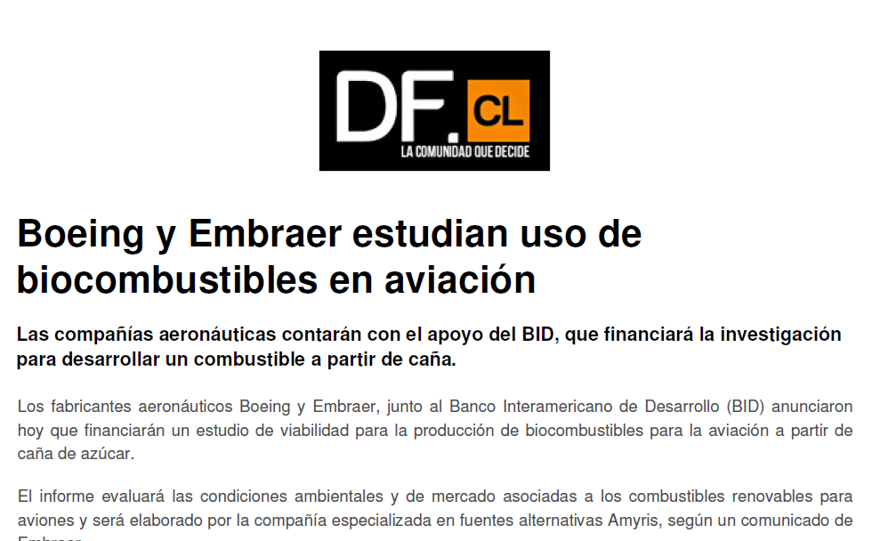
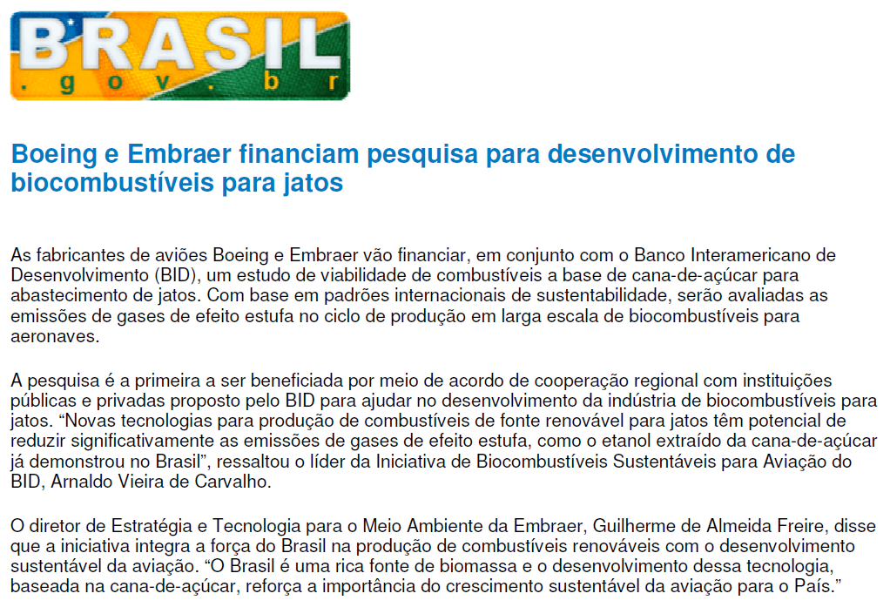
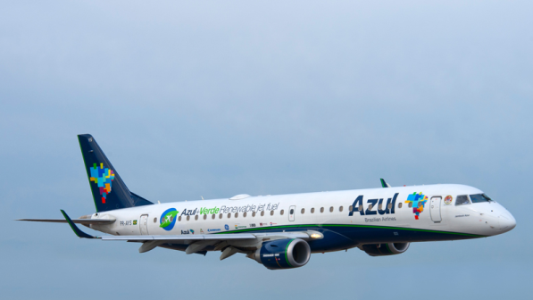
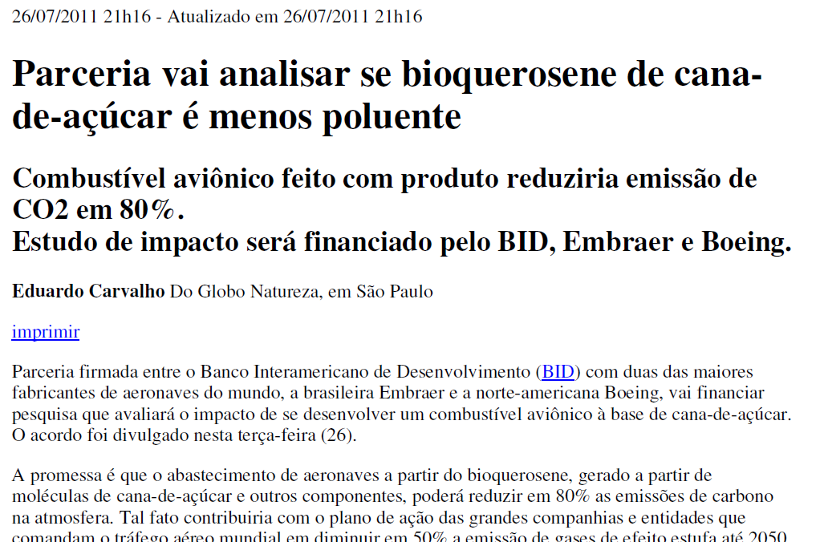
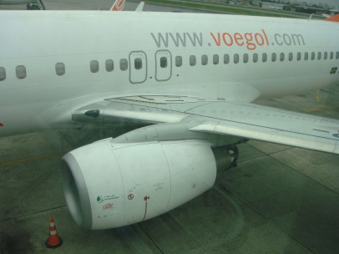
IDB & Sustainable Aviation Fuel

Slide 4
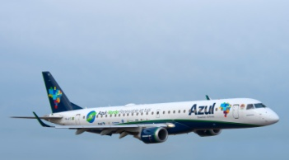

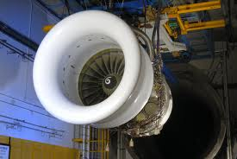
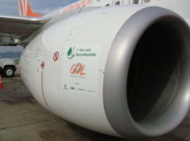
Aviation Biofuel
Feed stock & supply chain research
Brazilian aviation biofuel certification process
Brazilian ASTM fuel test capability
Brazilian rig and component testing equipment

Slide 5
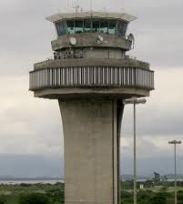
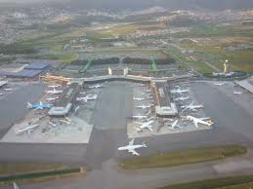
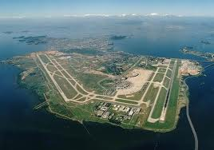
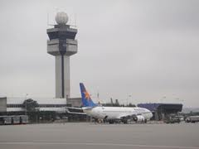
Operational Efficiency and Sustainability
Enhanced Air Traffic Capabilities
  Infrastructure (ATM, ATFM)
  Aircraft flight operations (PBN)
Enhanced Airport Operations

Slide 6
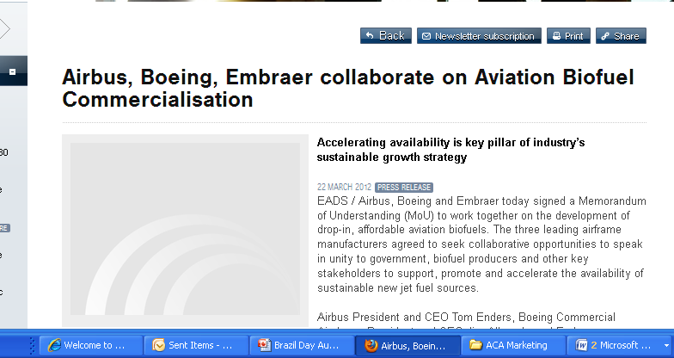


Collaborative Approach
Industry Associations (ABEAR, ALTA, IATA, ICAO, AIAB, ABRABA)
Road Map Process
BR/US bi-laterals
  Biofuel Initiative
  Aviation Protocol

Slide 7
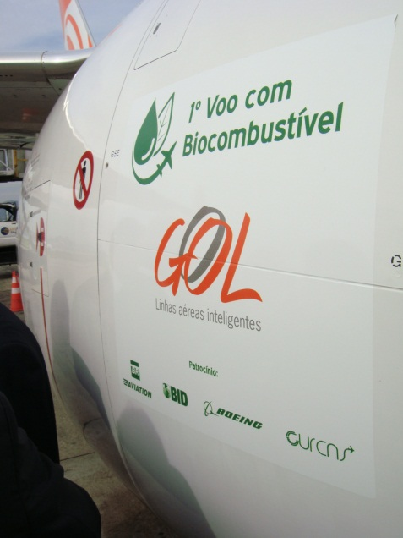

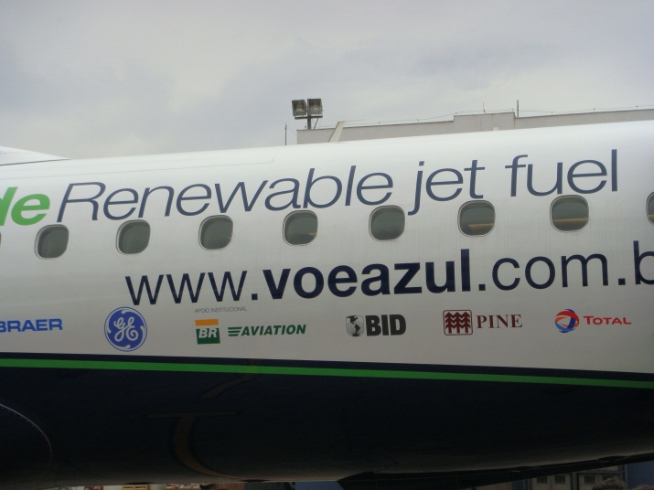
Support Brazil
Create jobs & sustainable economic growth
  Create aviation biofuel industry
  Enhance transportation infrastructure
Showcase airlines’ sustainability initiatives
Support Global Presence
  Pope’s visit
  Confederation Cup
  World Cup
  Olympics

Slide 8
Can IDB Help You?
Please contact us if you have an idea for how IDB can help improve aviation sustainability
Arnaldo Vieira de Carvalho arnaldov@iadb.org +1 202-341-8389
Donald P. Schenk dpschenk@aca-assoc.com +1 646-248-3461 | Tom Casey tcasey@aca-assoc.com +55 21-8459-0604
⇧

Slide 9
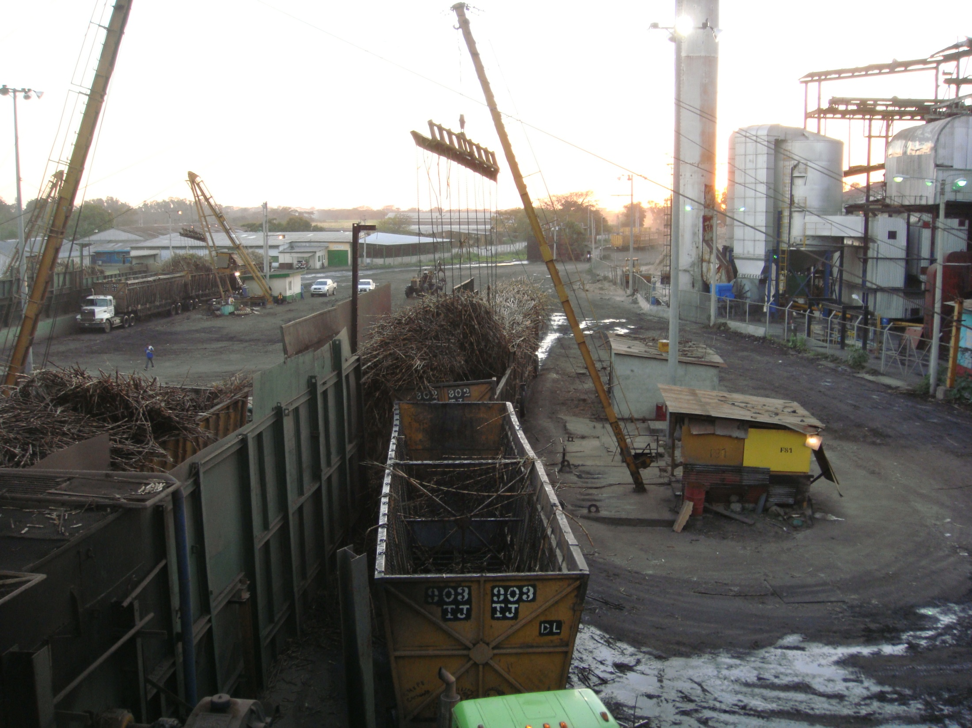

THANK YOU
9

